Slide 1
Company introduction

Slide 2
Content
Welcome to the Chris Mee Group!
The following is an introduction to the Chris Mee Group.
This course will cover:
The Management Team
Our Divisions
Our History
Our Clients
Our Mission Statement

Slide 3
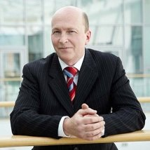
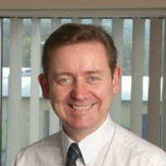
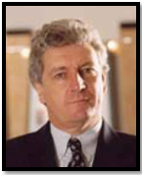
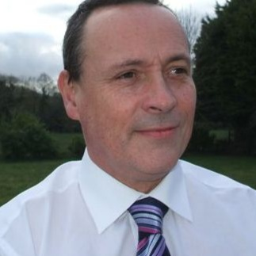
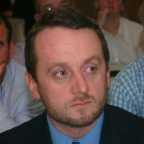
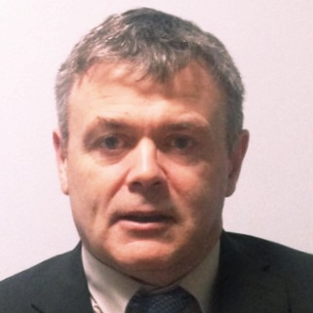
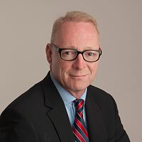
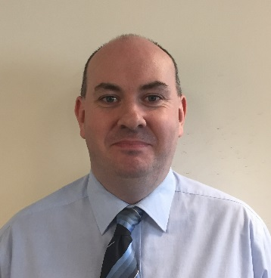
Management Team
Alf Smiddy
Group Chairman
Chris Mee
Managing Director
John McGowan
Director
Fergal Mee
Environmental Director
Darren O’Keeffe
Consultancy & Recruitment & Placement Manager
Ken Long
Central Services & Training Manager
Brian Murnane
Business Development Manager
Tim O’Brien
Finance & IT Manager

Slide 4




Our Divisions
The Chris Mee Group is divided into 4 divisions.

Slide 5
We work with our diverse client base to offer Contracting and Permanent employment across a range of industries including Pharma, Medical Device, Manufacturing, Construction and more.
Using our in house EHS expertise and industry knowledge, we identify talent, take the time to understand their needs and we work with our partners to find a role that fits.
CMSE Recruitment has almost 20 years’ experience providing excellent service to both employers and candidates across a changing employment market

Slide 6
We are leading providers of Environmental Health And Safety (EHS) training courses in Ireland & abroad. Venues: Dublin, Cork, London, Limerick, Galway and more.
CMSE Training is accredited by QQI, NEBOSH, IOSH, FÁS(SOLAS), STCW, SEAI, Canadian Standards and many more. We trained over 20,000 people last year.
Our E-Learning courses include the ALERT Driver Training Suite of courses, Manual Handling, Fire Safety and Chemical Safety.

Slide 7
We are a leading provider of Health And Safety related consultancy services in Ireland & abroad. We have over 100 consultants in Dublin, Cork and London. Our clients range from large multinationals to SMEs.
We provide safety management and risk management , environmental & energy services , fire & asbestos management, Behavioural Based Safety, PSDP, PSCS and more. We also provide a full range of CDM services in the UK and NI.

Slide 8
Carbon Action is a leading provider of Carbon consultancy services and Carbon Training Courses in the UK and Ireland. Carbon Action delivers hands on classroom training in carbon quantification, verification and management of carbon projects that conforms with the global standard - ISO 14064 and the GHG protocol.
Carbon Action is a strategic partner in the UK & Ireland for the Canadian Standards Association (CSA). The CSA was the World Secretariat during the development of ISO 14064 and Carbon Action has the exclusive rights to deliver CSA's ISO 14064 suite of five training courses.

Slide 9
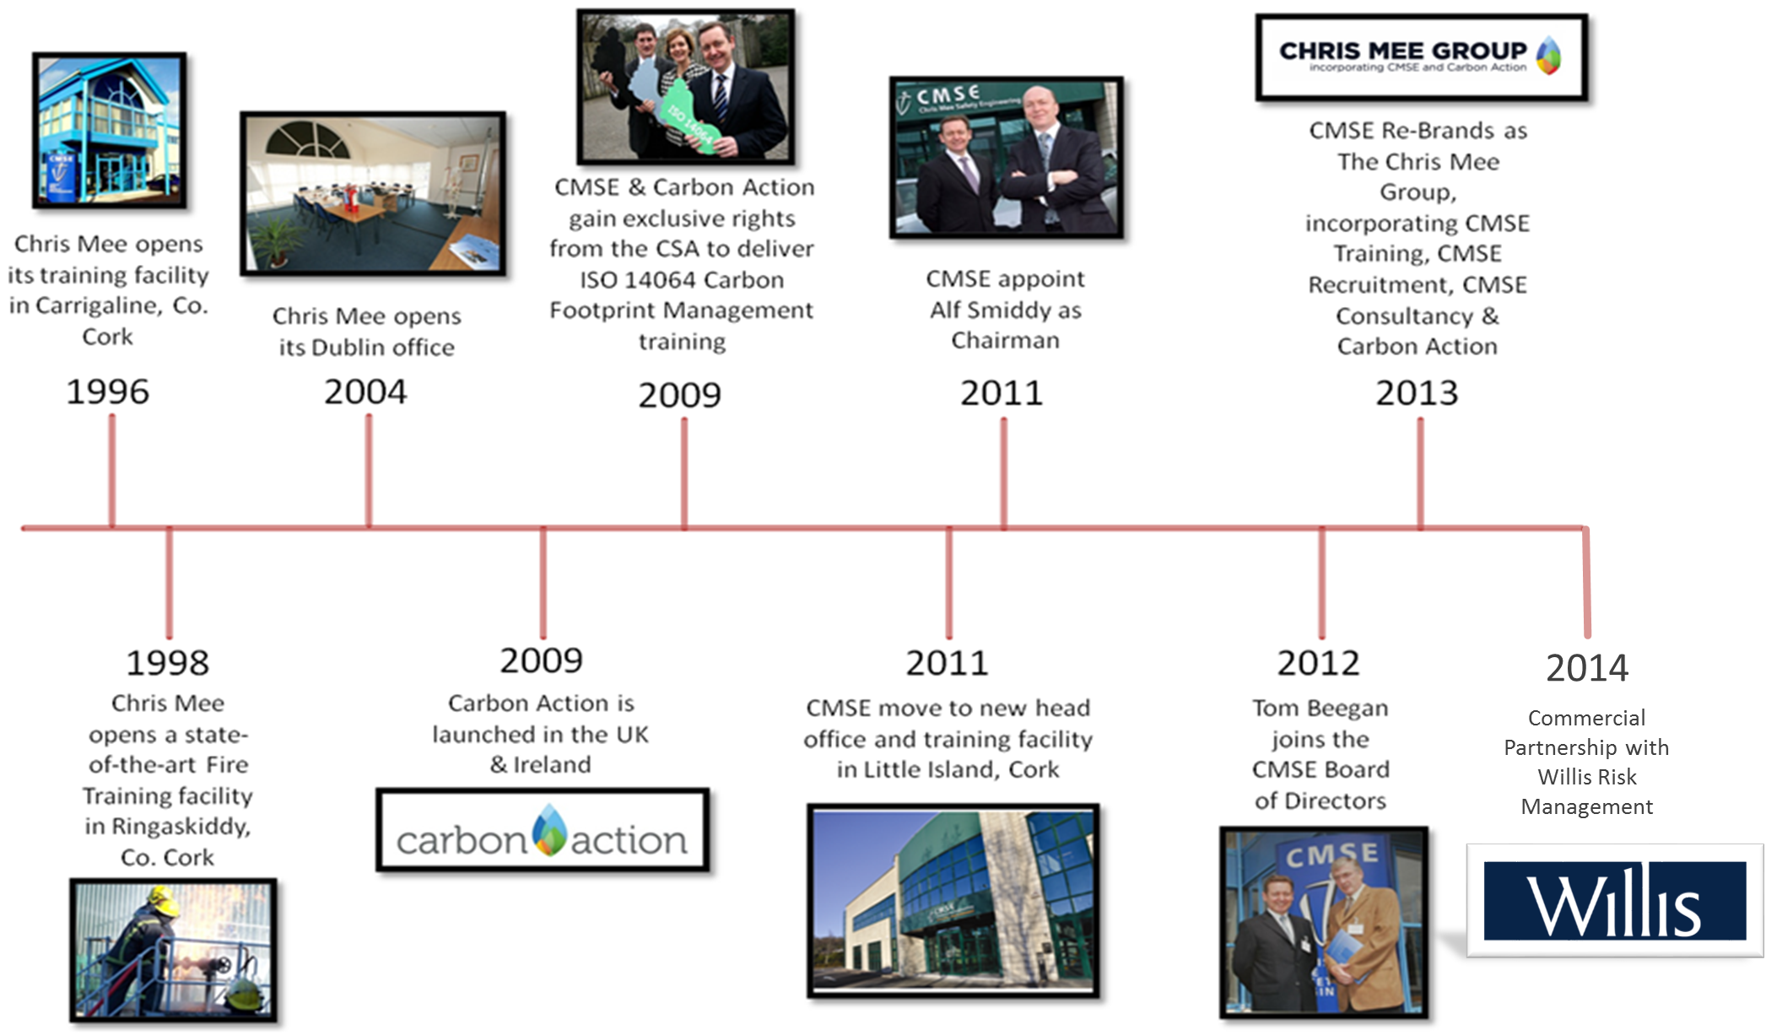
History

Slide 10
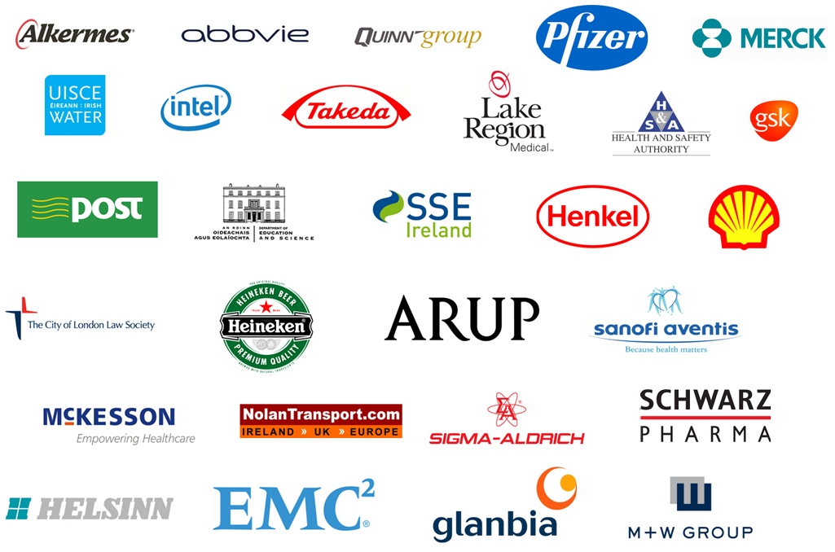
Clients
Our clients range from the pharmaceutical industry, education sector, public services, insurance sector, food manufacture, medical devices, construction and many more.

Slide 11
Company Mission Statement
To grow our business by excellent delivery of high quality professional services
To leverage technology to achieve international reach and scalability
To be the market leader and innovator in creating new customer solutions
To foster a learning organisation that supports continuous improvement and growth

