Slide 1
Hr induction

Slide 2
content
Welcome to the Chris Mee Group!
History and Mission Statement
Clients
Business Sections
Training services
Recruitment services
Consultancy Services
Organisational Chart

Slide 3
history
Chris Mee Group was founded in 1996 by a group of safety specialists and has expanded rapidly since, because of good quality work and repeat business
“One Stop Shop” philosophy
We have specialists in many different areas, covering health, safety, industrial hygiene, ergonomics, environmental, engineering, risk management and training
Sister company, Carbon Action, is a leading provider of classroom Carbon training in Ireland and UK. Carbon Action’s courses are based on the only global standard ISO 14064 and the Greenhouse Gas (GHG) protocol

Slide 4
Mission statement
“Chris Mee Group actively works to promote and support safety and health in both the workplace and the environment. We also commit to provide our clients with quality, care and support in an ever expanding range of safety, environment and training services.”

Slide 5
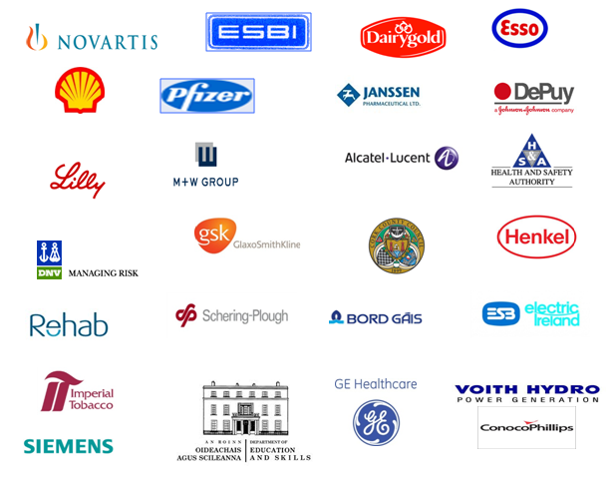
clients
Chris Mee Group markets include the public services, pharmaceutical industry, education sector, insurance sector, food manufacture, medical devices, construction and more
Some of our clients include:

Slide 6
Business Sections
The Chris Mee Group encompasses the following commercial service areas :
Recruitment
Consultancy
Training
Fire & Rescue Training Centre
Carbon
FRTC
Carbon
Action
CMSE Consultancy
Chris Mee Group
CMSE Recruitment
CMSE Training

Slide 7
ISO and OHSAS
Chris Mee Group is Certified in the following standards:
ISO 9001
ISO 14001
OHSAS 18001
Your assistance is requested to ensure compliance with the above management systems.

Slide 8
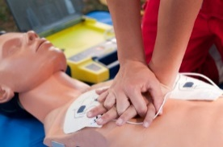
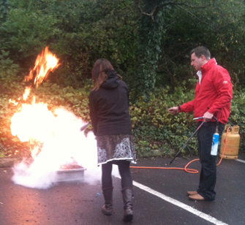
TRAINING SERVICES
FETAC COURSES
Occupational First Aid
Manual Handling Instructor
Safety Representatives
Train The Trainer
Health & Safety Certiﬁcate
BER Assessor
ONLINE TRAINING
Manual Handling Awareness
Fire Safety Awareness
Chemical Safety Awareness
Ergonomics
Decision based driver training
SPECIALIST TRAINING COURSES
Accident Investigation
Asbestos Awareness
Dignity & Respect In The Workplace
Gas Cylinder Training
Bullying in the Workplace
Electrical Safety
Safety Committee
Legionella Awareness
FIRE AND EMERGENCY MANAGEMENT
Fire Safety Engineering
Fire Risk Assessment
Emergency Plans & Crisis Management
Business Continuity Plan
EMERGENCY RESPONSE TRAINING
ATEX Awareness
Marine STCW Training
ERT Team Training
Evacuation Planning
FIRE SAFETY
Fire Warden
Fire Extinguisher
Trainee Fire Fighter
IOSH COURSES
Explosion Safety Management
Working Safely
Managing Safely
Managing Safely In Construction
CONSTRUCTION COURSES
PSCS & PSDP
Conﬁned Space
FAS Safe Pass
Working at Heights
NEBOSH COURSES
General Cert. In Occ. Health & Safety
Fire Safety & Risk Assessment
DRIVER TRAINING
Decision Driver Training
Forklift Training
Pallet Truck Training
MEWP
OFFICE SAFETY
Manual Handling
VDU / DSE Assessor

Slide 9
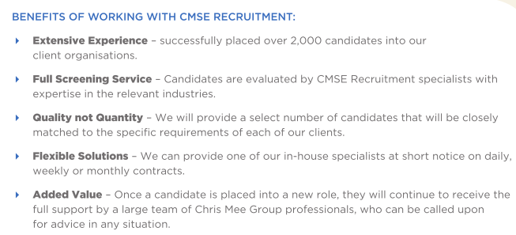
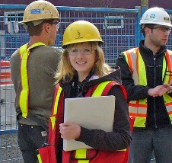
RECRUITMENT SERVICES
ENVIRONMENT, HEALTH & SAFETY
Managers
Officers
Occupational Health Advisors
Ergonomists
Industrial Hygienists
Process Safety Specialists
CONSTRUCTION / PROJECTS
Project Engineers
Project Managers
Quantity Surveyors
PSDP / PSCS
ENGINEERING
Process
Chemical
Mechanical
Civil
Project Validation
QUALITY
Quality Engineers
Quality Assurance
Quality Control Analysts
OIL & GAS
Engineers
Welders
Fitters
Electricians

Slide 10
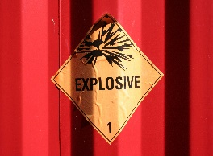
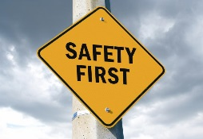
CONSULTANCY SERVICES
SAFETY MANAGEMENT CONSULTANCY
Safety Statements & Risk Assessment
Safety Auditing & Inspections
Accident Investigation Services
Behavioural Based Safety Programmes
Ergonomic and DSE Assessments
Manual Handling Assessments
Safety Management Systems OHSAS 18001
Machinery Safety
ENVIRONMENTAL / ENERGY SERVICES
Environmental Management Consultancy
ELRA and CRAMP
EMAS and ISO 14001
Energy Auditing
Waste Management
Dangerous Goods Safety Advisor
CONSTRUCTION SAFETY SERVICES
Construction Safety Auditing
Method Statements & Risk Assessments
Project Supervisor Construction Stage
Project Supervisor Design Process
OCCUPATIONAL HEALTH & HYGIENE
Occupational & Environmental Noise Surveys
Occupational Hygiene Monitoring Surveys
Air Quality Surveys
Asbestos Surveys
Legionella Risk Assessments
Chemical Agents Risk Assessments
PROCESS SAFETY CONSULTANCY
ATEX Consultancy Services
Process Safety Engineering
HAZOP
SEVESO / COMAH Compliance
FIRE AND EMERGENCY MANAGEMENT
Fire Safety Engineering
Fire Risk Assessment
Emergency Plans & Crisis Management
Business Continuity Plan

Slide 11
organisational CHART

